Slide 1
State of Nevada & Southwest Airlines

Slide 2
Agenda
Review Discount Agreement
Explain Southwest Airlines fares
Support contacts for State users
Notes:
1) Precall prep- university of Colorado as an example, them not knowing they were ranked in the top 25 of schools to attend
2) I have attended multiple travel fairs, SCTEM, and will be traveling with Justin throughout November to help educate Nevada travelers on SWABIZ
4) A-List requests, sending requests to CR liaisons, IRN reports for UC, setting meetings and creating agendas, cold calling accounts to find decision maker
5) federal government and Justin and trying to understand how everything works
7) I will be sending F emails to power 5 schools to find decision makers I also went through and prioritized the power 5 schools based on locations

Slide 3
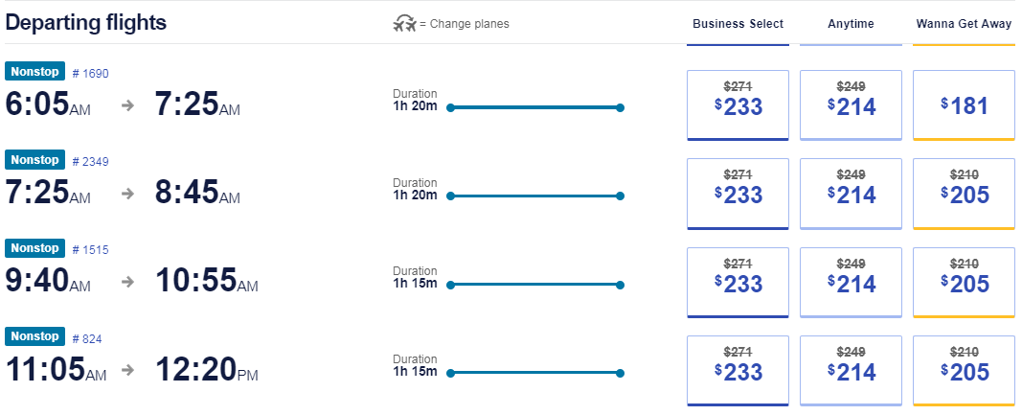
Southwest Airlines
Southwest Airlines new discounts create travel cost savings on all flights to/from Las Vegas and Reno.
15% off all Business Select® & Anytime fares
3% discount off select Wanna Get Away fares
  Discount applies to 0-7 day Advance Purchase fares

Slide 4
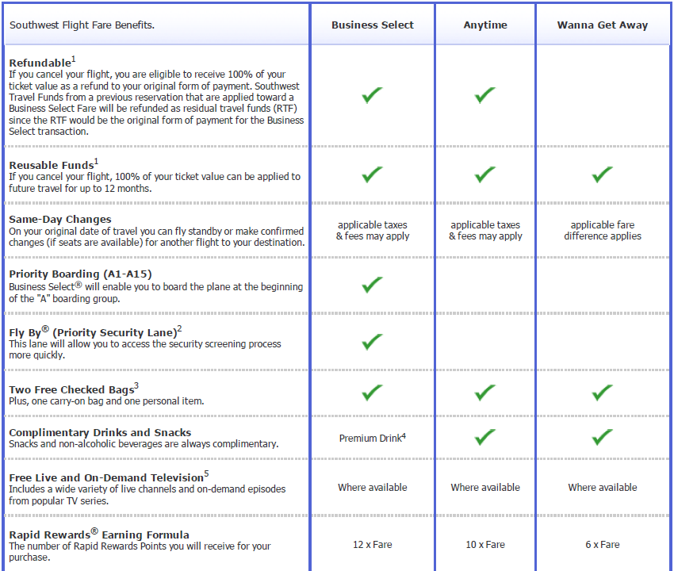
Southwest Airlines Fare Breakdown

Slide 5
Advanced Purchase pricing explained
Wanna Get Away fares are filed with advance purchase requirements
An advanced purchase requirement is a restriction that defines the last day a fare will be available on southwest.com
  For example, a 21AP is available from the date of schedule publish until the 21st day before departure
  At 20 days before departure, a higher priced 14AP fare will be now available, along with the 10AP, 7AP, 3AP, 1AP, and 0AP fares
$$$
$$
$
Anytime
0AP
1AP
3AP
7AP
10AP
14AP
21 AP
12/10 12/17 12/21 12/24 12/28 12/30 12/31
Available
Unavailable
Departure

Slide 6
Advanced Purchase pricing explained
The below example shows a booking made on 12/19, twelve days prior to departure
  On this date, Anytime, 0AP,1AP, 3AP, 7AP, 10AP fares are available for purchase, and 14-21AP fares are closed
  In this example, a 10AP was available and purchased
Date of purchase
$$$
$$
$
Anytime
0AP
1AP
3AP
7AP
10AP
14AP
21 AP
12/10 12/17 12/21 12/24 12/28 12/30 12/31
Departure
Available
Unavailable

Slide 7
Advanced Purchase pricing explained
The below example shows a booking made on 12/19, twelve days prior to departure
  On this date, by rule Anytime, 0-10 AP fares are available for purchase, and 14 & 21AP fares are closed
Unlike the prior slide, this flight is high demand and fewer seats remain for sale
  By rule the 7AP & 10AP fares would be available, however due to high demand, these fares are not available
  In this example, a 3AP was available and purchased
Date of purchase
$$$
$$
$
Anytime
0AP
1AP
3AP
7AP
10AP
7 & 10AP fares not available due to higher demand of fare classes
14AP
21 AP
12/10 12/17 12/21 12/24 12/28 12/30 12/31
Available
Unavailable
Departure

Slide 8
Advanced Purchase pricing explained
The below example shows a booking made on 12/10, twenty-one days prior to departure
  On this date, by rule Anytime, 0-21 AP fares are available for purchase
  Again, this flight is high demand and fewer seats remain for sale (10 & 14AP closed)
  In this example, a 7AP was available and purchased
Date of purchase
$$$
$$
$
Anytime
0AP
1AP
3AP
7AP
10AP
14AP
10AP, 14AP & 21AP fares not available due to closing of fare classes
21 AP
12/10 12/17 12/21 12/24 12/28 12/30 12/31
Departure
Available
Unavailable
Notes:
43% of 7AP fares are booked >14 days before departure¹
¹ Public fares only; Varies by Market and Account

Slide 9
Southwest Airlines Support Contacts
Contact Information
When to use for:
Corporate Travel Helpdesk
  1-877-633-4425
  CID# 99570273
  PIN 1861
SWABIZ® Helpdesk
  888-479-2249
Customer Relations
  1-855-234-4654
Morgan Bressler
  (214) 792-6971
Corporate Travel Helpdesk
  Priority expedited phone line that can help with general reservation issues, and apply discounts for phone reservations
  Do not share phone number for individual travelers
SWABIZ® Helpdesk
  Primary phone contact for SWABIZ® technical support issues
Customer Relations
  To request a refund, make a complaint or commendation, or for inquiries on your Rapid Rewards account
Morgan Bressler
  Unresolved SWABIZ® issues, new account setups, LUV Voucher requests, and additional SWABIZ® team training.

